Slide 1
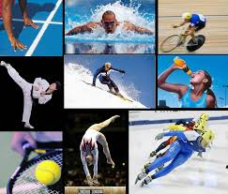
Canadian Athletes and Drugs

Slide 2
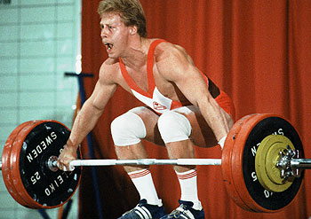
Pan-American Games 1983
Guy Greavette
Canadian Weightlifter
-Banned for the use of steroids
-Stripped of his medals
-Suspended for 2 two years from competetion

Slide 3
These games marked the dawn of the modern age of drug testing in sports.
After Guy and his fellow teammate Michel Viau tested positive, a dozen American athletes suddenly withdrew from the games
In total 19 athletes failed drug tests at these games

Slide 4
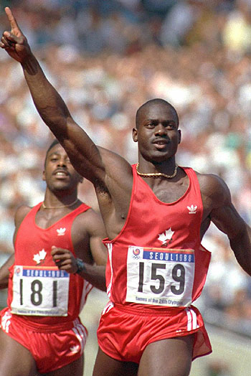
A Nation Disillusioned
In 1988, at the Seoul summer Olympics, Ben Johnson was the world’s fastest man. He put Canada on the world stage.
However, the glory was short lived.

Slide 5
Johnson set the world record for the 100 m dash
Claimed the gold medal defeating the American Carl Lewis
Johnson then tested positive for the steroid, stanazolol
He was stripped of his medal and banned from sports for 2 years
It was later discovered that several American track athletes tested positive prior to the games including Carl Lewis who was awarded the Olympic gold medal

Slide 6
Over-the-counter Mistakes
Silken Laumann – Canadian Rower
World champion
Olympic medalist
Pan Am games medalist

Slide 7
In the 1995 Pan Am games, quadruple scull team lost their gold medal. Silken tested positive for the steroid, psuedoephedrine.
Psuedoephedrine is a component of Benadryl Decongestant.
Silken asked team doctors for advice for a cold medications while at the games.
She mistakenly took the Benadryl Decongestant instead of Benadryl.

Slide 8
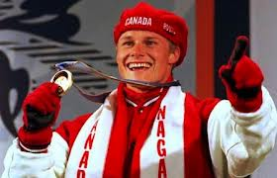
Second-hand Exposure
In 1998 snowboarding is a new sport for the Olympic games of Nagano, Japan
Canada’s excels with a gold medal for Ross Rebagliti

Slide 9
After winning the gold, Ross was tested
He showed positive for marijuana
Ross contented that is was second-hand smoke from a party thrown in his honour just before leaving for the Olympics
He was stripped of his medal
The medal was subsincely returned by an arbitration panel ruling
Marijuana is banned by the International Ski Federation but not by the IOC

Slide 10
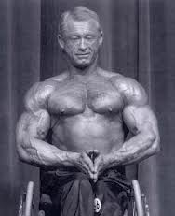
Disabled Athletes
Jack McCann
Disabled Weightlifting
1991 National Championship Gold Medal
Later strip of medal, after testing positive for stanzolol
Suspended for two years

Slide 11
Steve Vezina Amateur vs Pro
Steve Vezina is a NHL goalie who competed for Canada in the 1999 Pan Am games in Winnipeg
Steve’s roller hockey team won the gold medal at these games
Steve tested positive and he and his teammates were stripped of their gold medals
http://www.cbc.ca/archives/categories/sports/drugs-in-sports/going-for-dope-canada-and-drugs-in-sport/canadian-rollerhockey-player-tests-positive-team-loses-medals.html

Slide 12
Other Athletes
Kofi Yevakpor, sprinter: Banned for four years after testing positive for norandrosterone, a metabolite of nandrolone, and stanolozol at the Harry Jerome Track Classic in June 2001.
Eric Lamaze, equestrian rider: Missed 2000 and 1996 Olympics after testing positive for cocaine use. Lifetime ban lifted after second drug test, but refused back on Sydney Olympic team on grounds he violated athletes' agreement.

Slide 13
Robin Lyons, hammer throw: Suspended from the Canadian Olympic team in August 2000 after positive test for the anabolic steroid norandrosteroneat the Canadian Olympic trials in August.
Eric Chevrier, weightlifter: Banned for life in August 2000 after testing positive for human chorionic gonadotrophin. Also tested positive for banned substances in 1993.

Slide 14
Glenn Ennis, rugby: Canadian international given four-year suspension after testing positive for cocaine. Suspension overturned in July 1999 because of "exceptional circumstances."
Roger Harripersad, racquetball: Suspended for four years in 1993 after positive drug test.
Cheryl Thibedeau, sprinter: Banned for life after testing positive for steroids in 1992.

Slide 15
Brian Morrison, sprinter: Suspended for two years after testing positive for steroids in 1990.
Julie Rocheleau, hurdler: Suspended for two years in 1989 after testing positive for steroids.
Terry Hadlow and Luc Chagnon, weightlifters: Dropped from 1984 Olympic team after positive test for steroids.
Oral O'Gilvie, tripled jumper: Four years for doping infraction in 1993.

Slide 16
Drugs and Sports
The following interview with John Stossel addresses drugs in sports in light of Lance Armstrong’s drug doping scandal
http://youtu.be/GqbbmJNvuGQ

