Slide 1
Learning Goals:
Explain the difference between an addition reaction and a condensation polymerization reaction
Draw polymer structural diagram, given the monomer.
Draw monomer structure(s), given the polymer.
Propose a personal course of action to reduce the use of compounds that are harmful to human health and the environment.

Slide 2
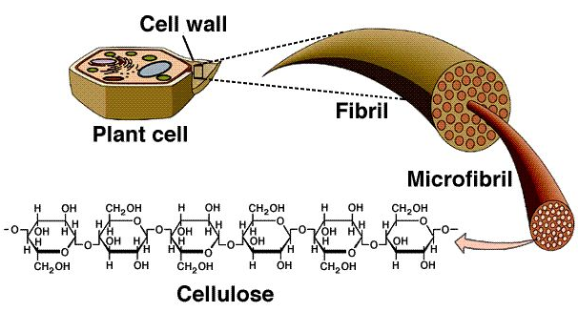
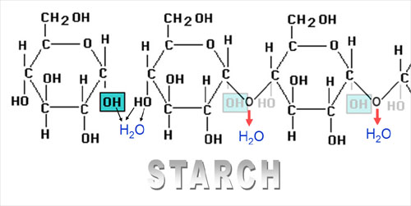
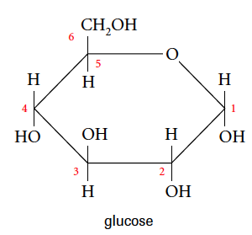
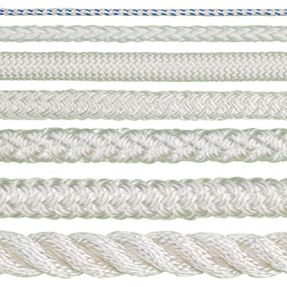
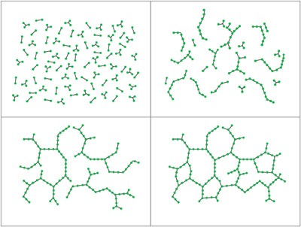
Polymers
Poly-mer= “Many parts”
Large molecules that are made by linking together smaller molecules “monomers
Properties of polymer resemble properties of monomers
Natural Polymers: carbohydrates (sugars), proteins (amino acids), DNA (genetic material)
Synthetic Polymers: Plastics are considered polymers
Strength, flexibility, transparency, stability
Notes:
Cellulose and starch are polymers of glucose

Slide 3
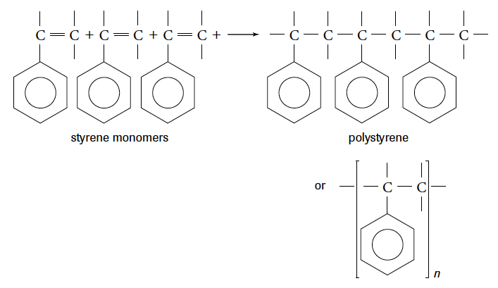
Polymerization: Addition Polymers
result from the addition of small subunits “monomers” with double bonds
Polymers are generally unreactive (why?)= good containers
Plastics are flexible and can be molded by heat (disrupts IMF)
What is the effect of adding electronegative groups to monomers? (Polyethene vs. PVC )
Notes:
Flexible because long chain monomers held together by intermolecular forces- big molecules have greater dispersion forces
What is the effect of adding EN groups (F)= Teflon= tetrafluoroethene cf=cf, stronger forces, less likely to react
branched polymers (ex. LDPE- brances due to addition of butadiene) prevent molecules from packing as tightly together as unbranched HDPE.

Slide 4
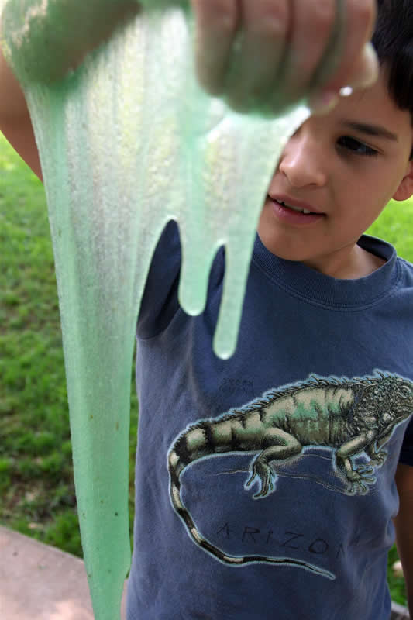
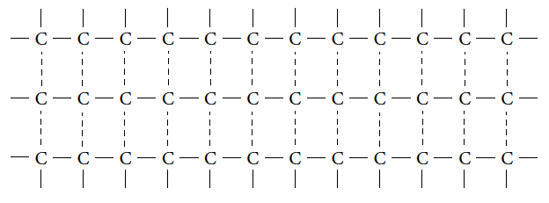
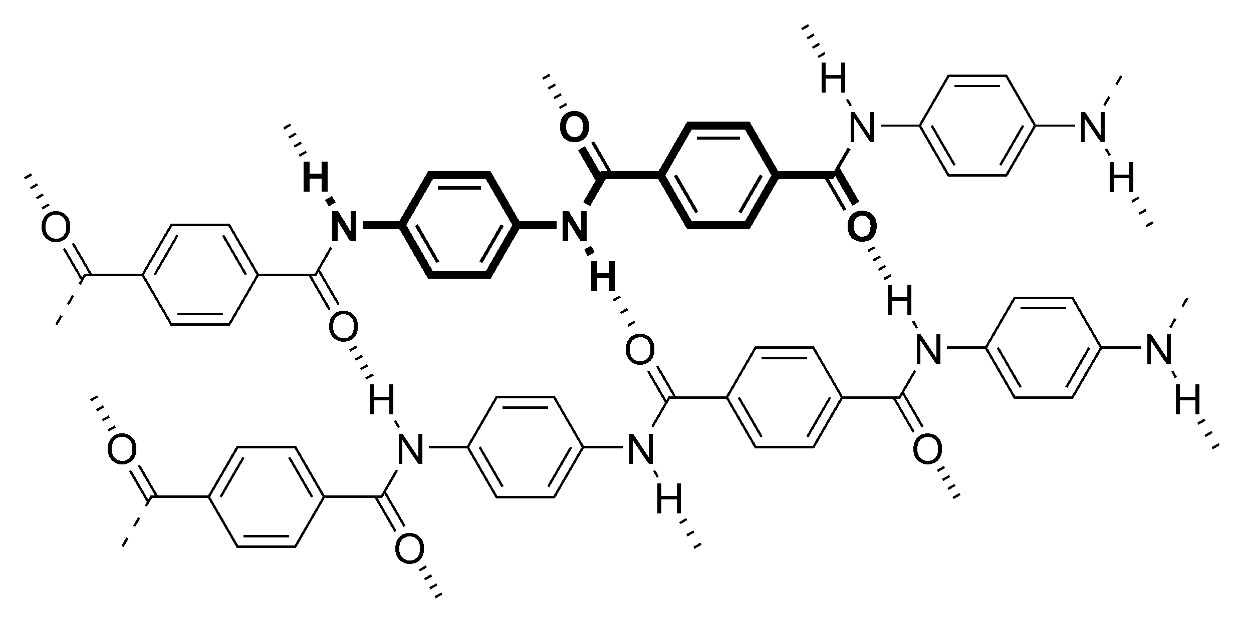
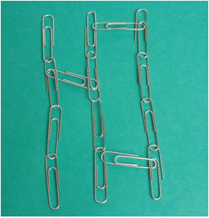
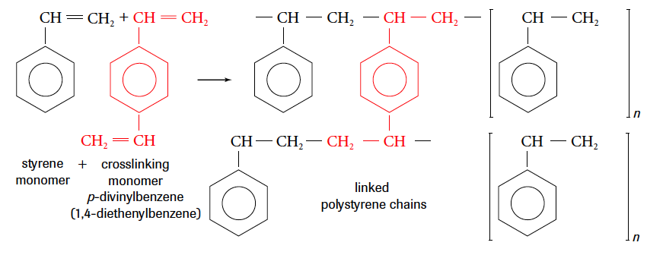
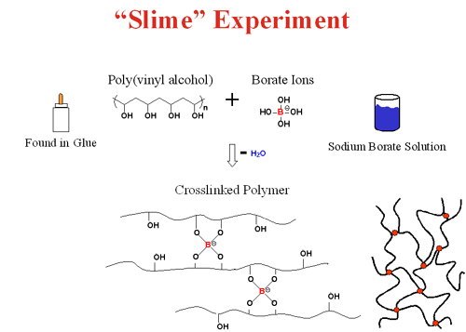
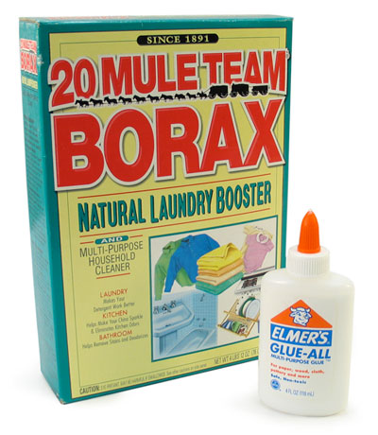
Interactions between Polymers
London-Dispersion
Dipole-Dipole
H-Bonding
3. Crosslinking: Strong covalent bonds between adjacent polymer chains Stronger plastics= Dienes or Trienes

Slide 5
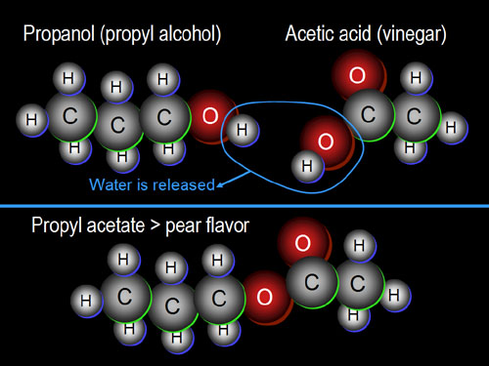
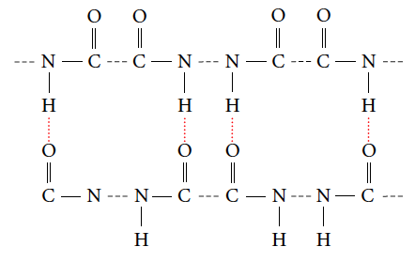
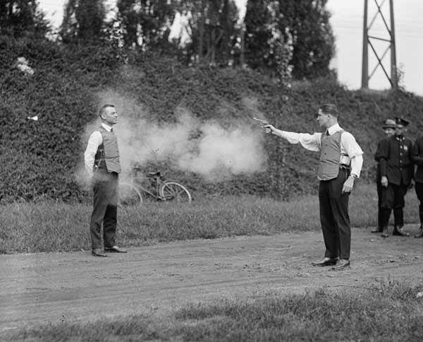
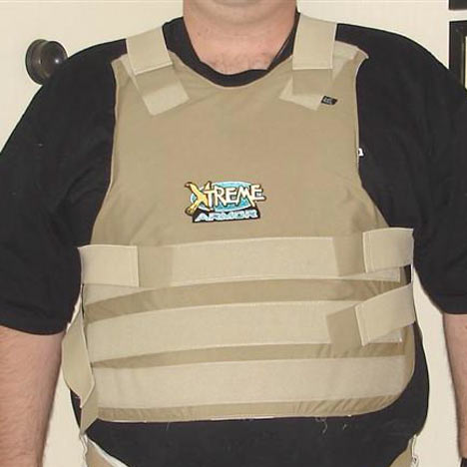
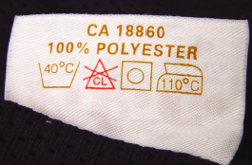
Polymerization: Condensation Polymers
Very strong fibers…why? Ex. Kevlar is used in aircrafts, firefighters, bullet proof vests AND is stronger than steel
Condensation Polymer: a polymer formed
by the release of H2O
Polyesters
Polyamides

Slide 6
HW: Read p. 78
Identify 10 substances that are made of polymers.
What is the major source of most plastics? Why is this problematic?
How is the stability of plastics helpful to society? harmful to the environment?
What actions can be taken on a personal level to reduce your use of plastic?
Name 5 natural polymers.
Name 5 synthetic polymers.

Slide 7
HW:
p. 87 #1-3
p. 93 #1,2
p. 98 #1
p. 99 #3-6

Slide 8
Fun with Polymers
Dissect a Diaper
Oobleck
Slime

